Slide 1
GULF INSURANCE GROUP · SAUDI ARABIA
A new GIG website.
Faster. Clearer. In two languages.
This talk covers the design, the CMS, the cost, the timeline, and how we will measure results.

Slide 2
CONTENTS
Five parts
1. The problem with the current website
2. The new design
3. How we keep the site this clear
4. Cost and timeline
5. PostHog analytics

Slide 3
THE PROBLEM
People come to buy insurance. They do not come to read menus.
They want a price for a car, health, travel, or home. They are in a hurry. If the price form is not on the first screen, many people leave.

Slide 4
CURRENT WEBSITE
The top bar shows the company structure. It does not help the visitor start.
Individual, Business, Complaints, Call us, Branches, Search — then the product.

Slide 5
CURRENT WEBSITE
Four extra steps before a price
1. Choose Individual or Business
2. Open a long product menu
3. Scroll past banners
4. Find the quote form

Slide 6
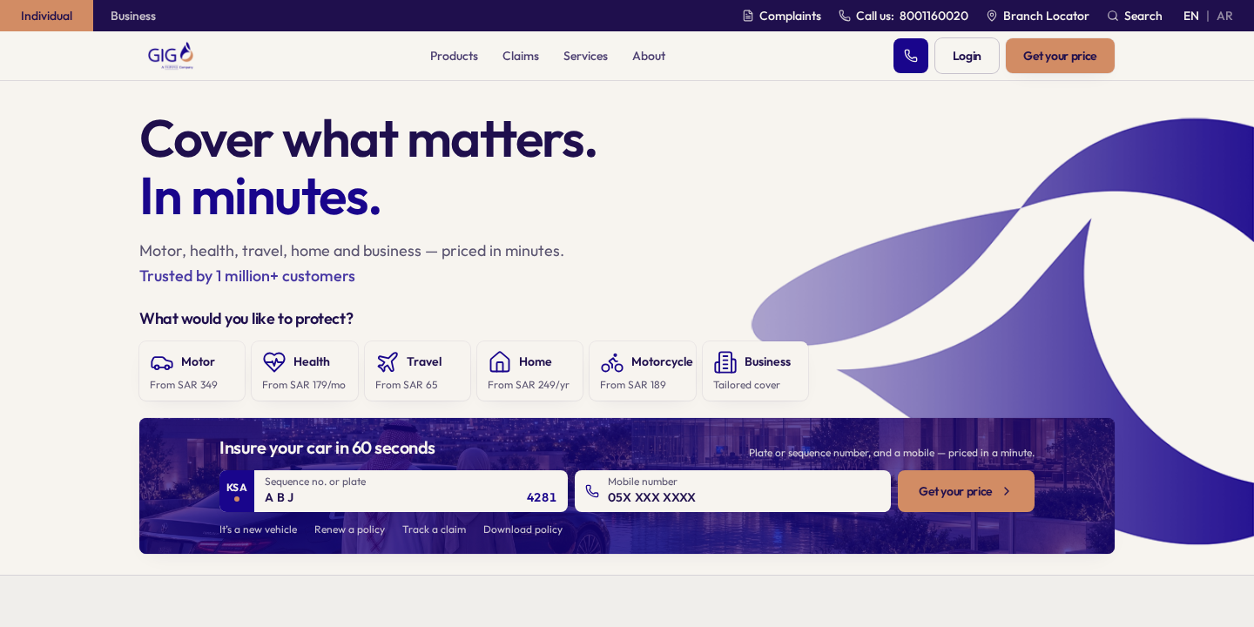
NEW WEBSITE · FIRST SCREEN
Title. Six products. Car plate and phone. Get your price. All on the first screen.

Slide 7
WHAT WE CHANGED
The first screen does the job
1. Headline is two lines only: Cover what matters. In minutes.
2. Six products with a starting price
3. Car plate + mobile number + Get your price
4. Call, Login, and Get your price stay in the header

Slide 8
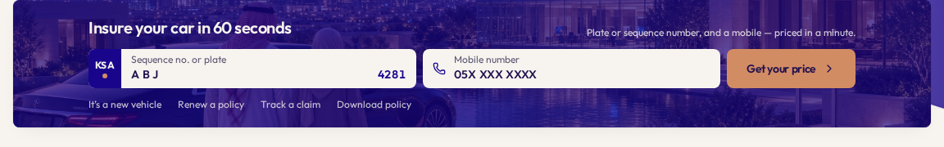
CAR INSURANCE
Insure your car in 60 seconds. Enter plate and mobile. See a price.

Slide 9
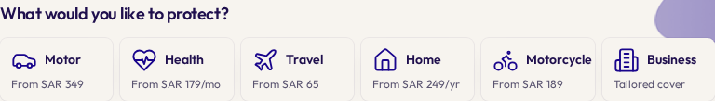
PRODUCTS
Show the starting price. Do not hide it.
Motor from SAR 349. Health from SAR 179 per month. Travel from SAR 65.

Slide 10
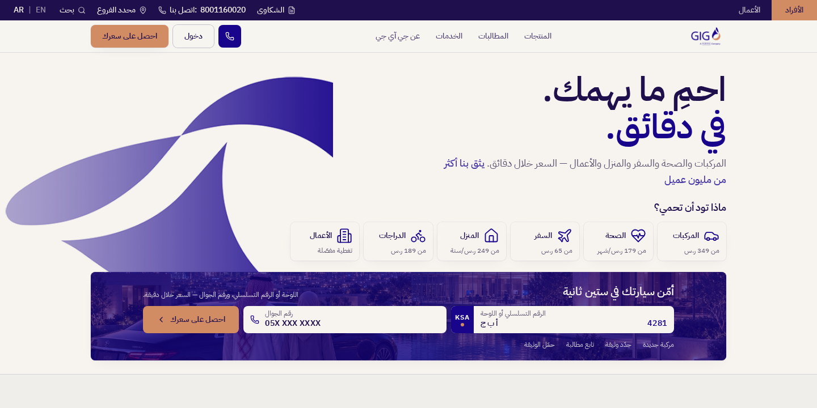
ARABIC
English and Arabic are equal. The page flips right-to-left. The car plate stays left-to-right.

Slide 11
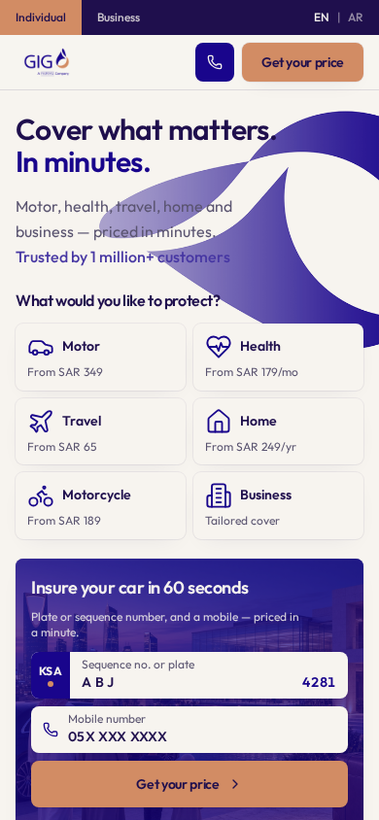
PHONE
Same idea on a small screen: products first, then the price form.

Slide 12
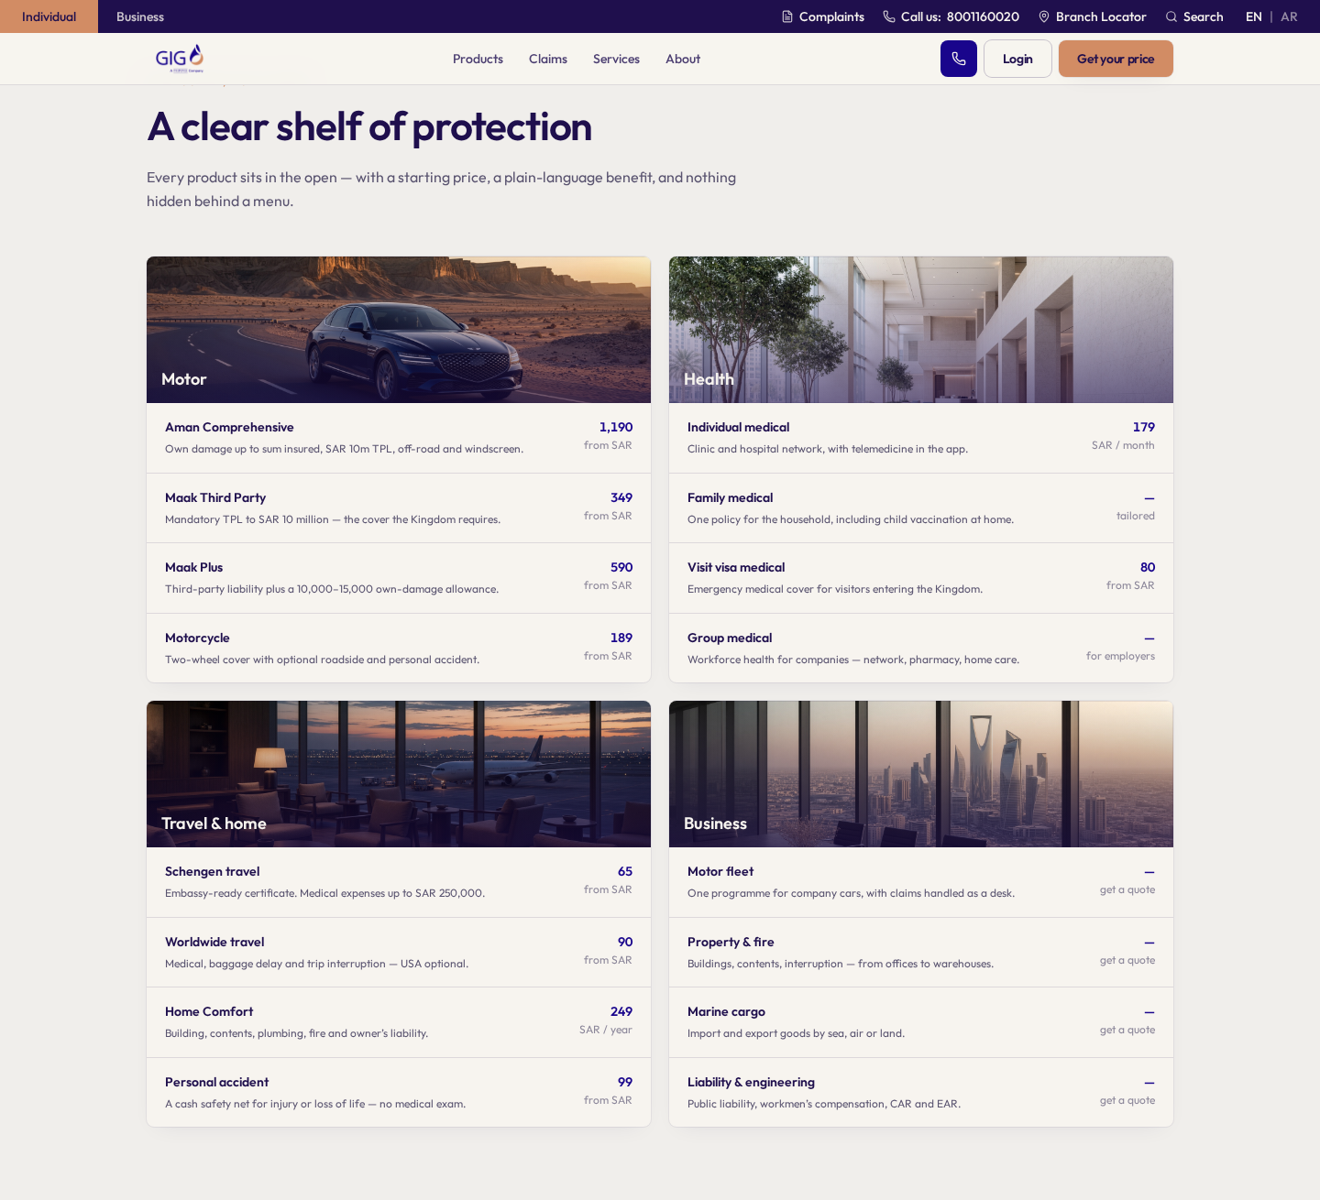
AFTER THE FIRST SCREEN
A simple list of products and prices. Then claims, the app, and customer stories.

Slide 13
THE CMS
The design is not finished at launch. It has to survive the next two years.
The question for management is not “do we like Payload.” The question is: who can change the homepage, how fast, and can they break the first screen.

Slide 14
THREE WAYS TO RUN THE SITE
Only one keeps this homepage
No CMS
Marketing waits for an engineer for every price, Ramadan line, or product change. In six months they will ask for WordPress.
A page-builder CMS
WordPress, Sitecore, typical Umbraco. Editors get a canvas. They add a second banner, a popup, a slider. That is how the current site grew four extra steps before a price.
A headless CMS
The website is the design. The CMS is a form. Marketing fills price, title, and Arabic text. They cannot invent a new layout.

Slide 15
WHAT HEADLESS MEANS HERE
Marketing edits fields. They do not edit the page.
1. Change “from SAR 349” without calling engineering.
2. English and Arabic sit on the same product. One price. Two texts. They cannot drift.
3. Turn a Ramadan line on and off. The first screen still has one hero, six products, and the quote form.
4. Preview before publish. Arabic layout is checked automatically.
5. If legal says host in Saudi Arabia, the database lives there.

Slide 16
WHY PAYLOAD
It is the cheapest way to lock the design we just paid for.
1. We own it. No fee per editor, per language, or per entry. Tools like Contentful bill that way, and the invoice grows with the site.
2. The homepage is a content model, not a blank page. There is no “add another hero” button.
3. Same technology as the website. One team. One vendor list. No extra Sitecore or Adobe contract.
4. Free licence. We pay for servers in the Kingdom, not a US SaaS bill tied to traffic.
5. The content is ours. If Payload is wrong later, we can move it. We are not trapped.

Slide 17
COST
About $220,000. About SAR 825,000. About 18 weeks.
$175–265k
Range. Higher if the quote API is slow or old.
18 weeks
From start to public launch.
Included
Homepage, product pages, CMS, Arabic, quote link, PostHog, launch.
Not included
Core policy system, rating engine, mobile app rebuild.

Slide 18
COST DETAIL
Where the money goes
Work | USD
Plan the content model | 18k
Build the website from this design | 52k
Payload CMS, Arabic, preview | 46k
Connect quote, login, branches | 28k
Move content and test both languages | 22k
Access, speed, search, redirects | 16k
PostHog setup | 10k
Launch and training | 14k
Buffer 15% | 31k
Total | 237k

Slide 19
TIMELINE · 18 WEEKS
Five phases
If we start in October, we can launch in February. Ramadan is a content change, not a rebuild.
W1–2
Plan
Content model. First-screen rule.
W3–6
Homepage
Build the real page from this design.
W7–10
Flows
Quote, products, claims, app.
W11–14
Quality
Arabic, tests, PostHog.
W15–18
Launch
Move traffic. Watch numbers. Fix.

Slide 20
DONE MEANS
Four checks. All must pass.
1. The price form is on the first screen, in English and Arabic, on phone and desktop.
2. A marketer can change a starting price without an engineer.
3. PostHog shows: visit → product → start quote → get price.
4. Arabic layout and access tests run automatically.

Slide 21
POSTHOG
Google Analytics counts page views. PostHog tells us where people stop.
We will see if they click a product, if they type a plate, and if they get a price. Then we watch a recording of the people who stopped.

Slide 22
THE MAIN PATH WE WILL MEASURE
From visit to purchase
1. Open the homepage
2. Click a product
3. Type plate or mobile
4. Click Get your price
5. See a price
6. Buy the policy

Slide 23
WHAT WE WILL TEST
Four experiments
Button words
Get your price vs Get a quote. We keep the one that gets more prices.
Product order
Motor first vs other order. We keep the one people use.
Default language
Arabic first vs browser language. We keep the one with more completed quotes.
Privacy
Hide plate, mobile, and ID in recordings. Host in the EU or in Saudi Arabia if legal asks.

Slide 24
PLEASE APPROVE
Four decisions
1. Keep this first screen as the rule.
2. Budget about $220,000 and 18 weeks.
3. Use a headless CMS (Payload), hosted in Saudi Arabia if needed.
4. Turn on PostHog before launch, not after.

Slide 25
